Slide 1
Training a Multilayer Perceptron with Stochastic Gradient Descent
Landon Buell
11 March 2020

Slide 2
Overview
Introduction to Multilayer Perceptron
Mathematical Treatment & Forward Feeding
Minimizing the Error Function
Correcting with Gradient Descent
Understanding the Scikit Learn Implimentation

Slide 3
The Multilayer Perceptron Classifier
Sklearn : “MLPClassifier”

Slide 4
Layout
Common Architecture (Geron)
A Series of “layers”
Each layer of made up of Nodes or Neurons
Developed in 1980’s

Slide 5

Mathematical Treatment
Each layer of Neurons can be treated as a N x 1 Column vector
We identify the l-th layer as : ${\overset{⃑}{x}}^{(l)}$
The i-th element as : ${\overset{⃑}{x}}_{i}^{\left(l\right)}$
The number of neurons in the l-th layer is $n_{l}$
Layers are usually 0 – indexed, with ‘L’ layers
Input layer is “Layer 0”
Output layer is “Layer L-1”

Slide 6

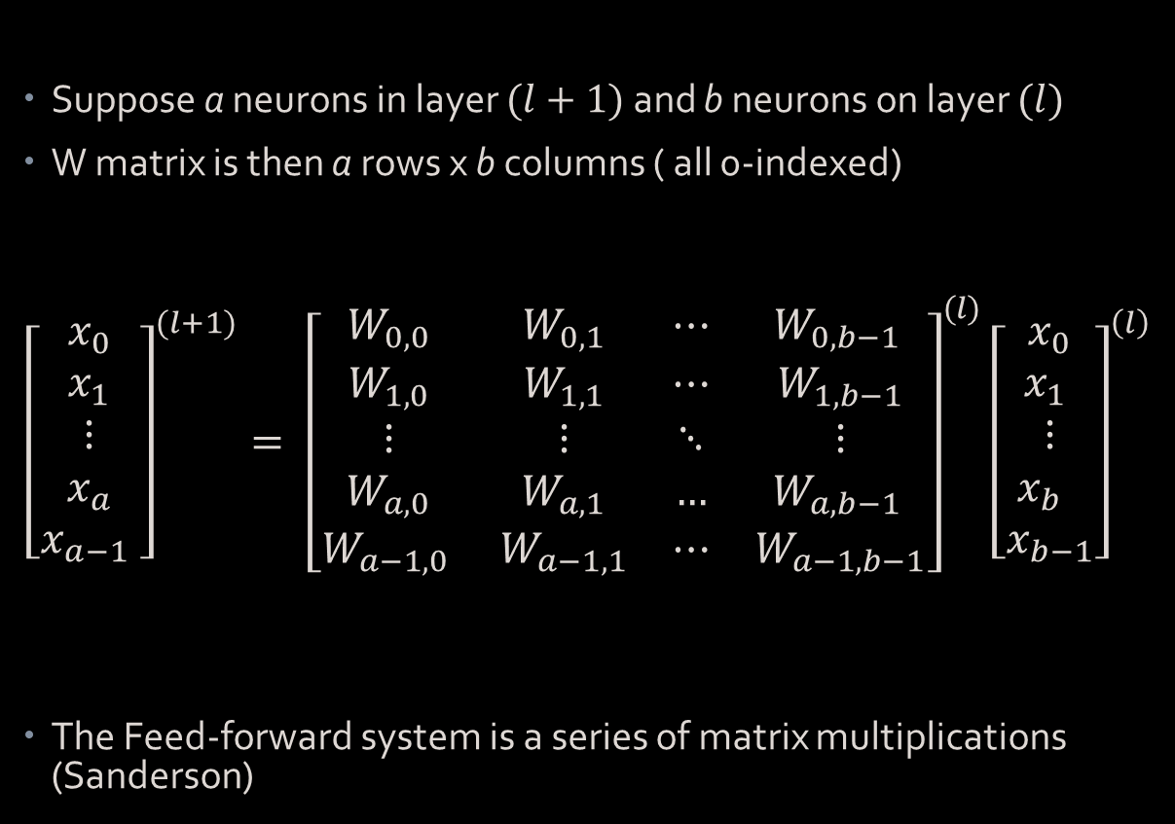
Feed-Forward System
Suppose a neurons in layer $(l+1)$ and b neurons on layer $(l)$
W matrix is then a rows x b columns ( all 0-indexed)
$${\left[\begin{matrix}x_{0} \\ x_{1} \\ ⋮ \\ x_{a} \\ x_{a−1} \end{matrix}\right]}^{(l+1)}= {\left[\begin{matrix}W_{0,0} & W_{0,1} & ⋯ & W_{0,b−1 } \\ W_{1,0} & W_{1,1} & ⋯ & W_{1,b−1} \\ ⋮ & ⋮ & ⋱ & ⋮ \\ W_{a,0} & W_{a,1} & … & W_{a,b−1 } \\ W_{a−1,0 } & W_{a−1,1} & ⋯ & W_{a−1,b−1}\end{matrix}\right]}^{(l)}{\left[\begin{matrix}x_{0} \\ x_{1} \\ ⋮ \\ x_{b} \\ x_{b−1}\end{matrix}\right]}^{\left(l\right) }$$
The Feed-forward system is a series of matrix multiplications (Sanderson)
Matrix – Vector Equation:
$${\overset{⃑}{x}}^{l+1}=W^{l}{\overset{⃑}{x}}^{l}$$

Slide 7

For a “Trained Network”
A trained network with L layers
A prediction is given by of L-1 matrix products
$${\overset{⃑}{x}}^{(L−1)}=W^{(L−2)}W^{(L−3)}…W^{\left(1\right)}W^{\left(0\right)} {\overset{⃑}{x}}^{(0)}$$
Superscripts indicate a layer index

Slide 8
The Cost Function
The function to minimize

Slide 9
Nature of the Function
Cost function – Error Function – Objective Function – Loss Function (James)
This is the function that we try to minimize
Determined by MLP’s output and the target associated with a training sample (Geron)

Slide 10

Computing the Cost Function
The Network’s final layer (L-1) outputs a vector
For a k-bins classifier, this vector is shaped: $k×1$
The target associated with the sample is also arranged into a
$k×1$ vector.

Slide 11
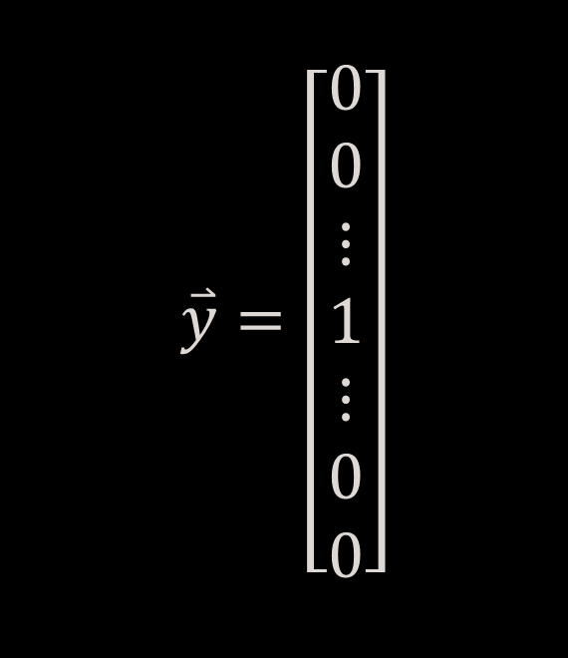
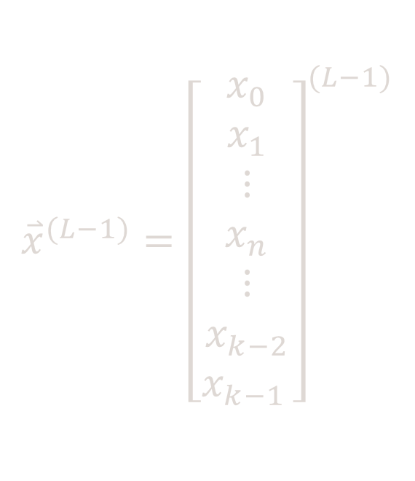
Example Output Suppose Sample belongs to class ‘n’
MLP Output Vector
Sample Target Vector
$${\overset{⃑}{x}}^{(L−1)}={\left[\begin{matrix}x_{0} \\ x_{1} \\ ⋮ \\ x_{n} \\ ⋮ \\ x_{k−2} \\ x_{k−1 }\end{matrix}\right]}^{(L−1)}$$
$$\overset{⃑}{y}=\left[\begin{matrix}0 \\ 0 \\ ⋮ \\ 1 \\ ⋮ \\ 0 \\ 0\end{matrix}\right]$$

Slide 12
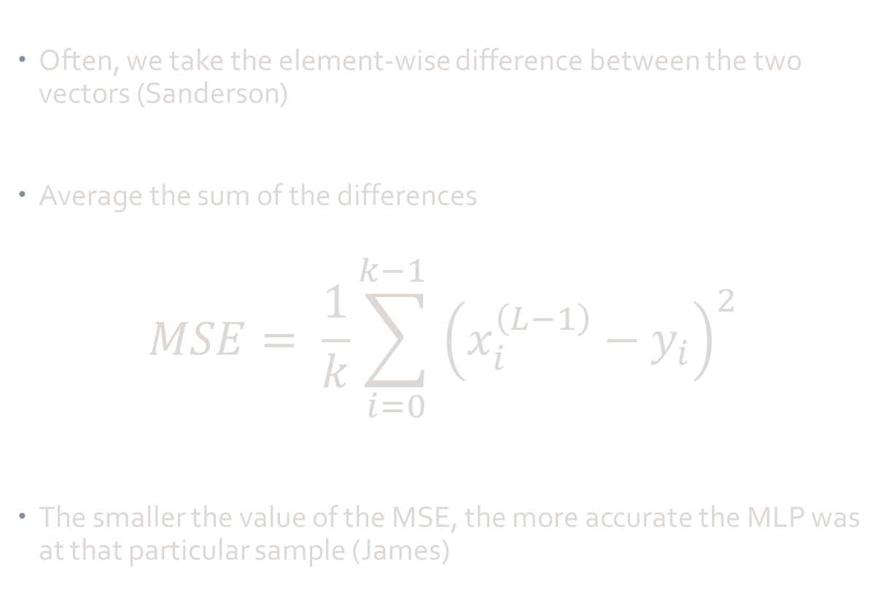
Mean Squared Error
Often, we take the element-wise difference between the two vectors (Sanderson)
Average the sum of the differences
$$MSE= \frac{1}{k}\sum_{i=0}^{k−1 }{{\left(x_{i}^{\left(L−1\right)}−y_{i}\right)}^{2}}$$
The smaller the value of the MSE, the more accurate the MLP was at that particular sample (James)

Slide 13
How to minimize the cost function?

Slide 14
Stochastic Gradient Descent
Training Algorithm

Slide 15
The Cost Function Revisited
The Cost function is based on the MLP output and the target vector
The output of the MLP is a function of the input vector
The input vector is transformed through each weighting matrix
Thus, the cost function is a function of all the weighting matrices

Slide 16
Implications
The Cost function is then determined by many variables
Every element in every weighting matrix contributes to the error function (Sanderson)
For larger networks, this can extend to several thousand variables
We use Stochastic Gradient Descent to adjust these inputs (Goodfellow)

Slide 17

Forward Feeding
When fitting, partial fitting or predicting, the MLP uses the forward-feed method as previously outlined
Recursive matrix multiplications
In Python 3.X uses “a @ b” which is $O\left(n^{3}\right)$ [Citation needed]
Once the last layer is reached, these activations are the MLP’s decision

Slide 18

Back Propagation
Gradient Descent is Linear Model – Almost like a linear regression
We have coefficient and intercept parameters
Back propagation uses a series of more matrix multiplications
Starting with last layer – compute “delta” array
Element-wise:
$$\vec{Δ}={\overset{⃑}{x}}^{(L−1)}−\vec{y}$$

Slide 19
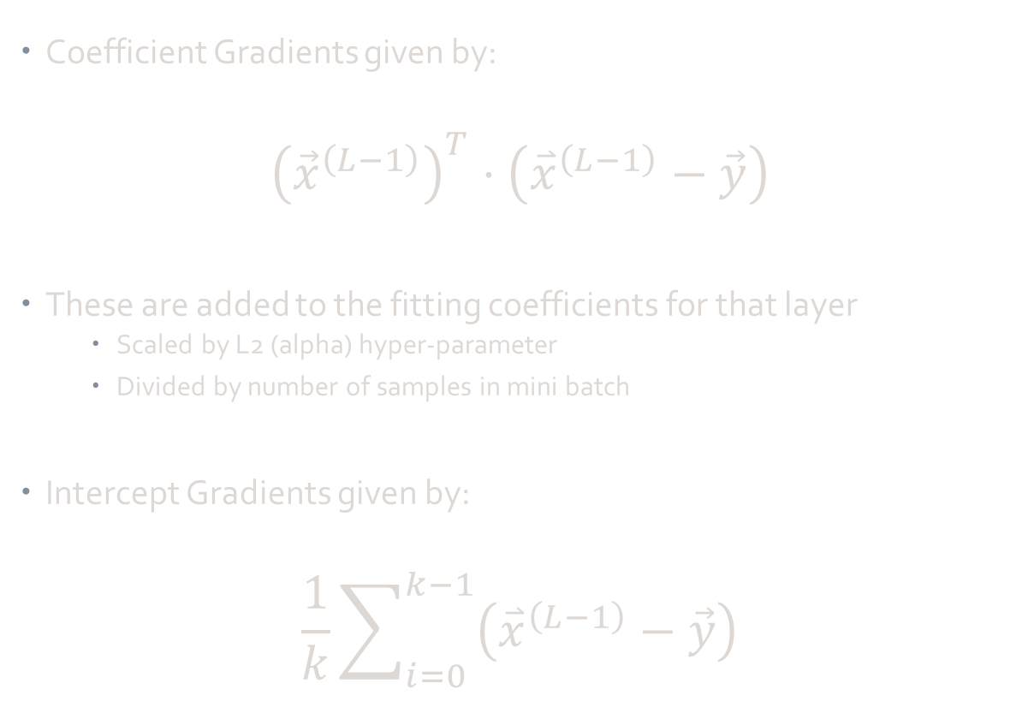
Loss Function Gradient
Coefficient Gradients given by:
$${\left({\vec{x}}^{\left(L−1\right)}\right)}^{T}⋅\left({\overset{⃑}{x}}^{\left(L−1\right)}−\vec{y}\right)$$
These are added to the fitting coefficients for that layer
Scaled by L2 (alpha) hyper-parameter
Divided by number of samples in mini batch
Intercept Gradients given by:
$$\frac{1}{k}\sum_{i=0}^{k−1}{\left({\overset{⃑}{x}}^{\left(L−1\right)}−\vec{y}\right)}$$

Slide 20
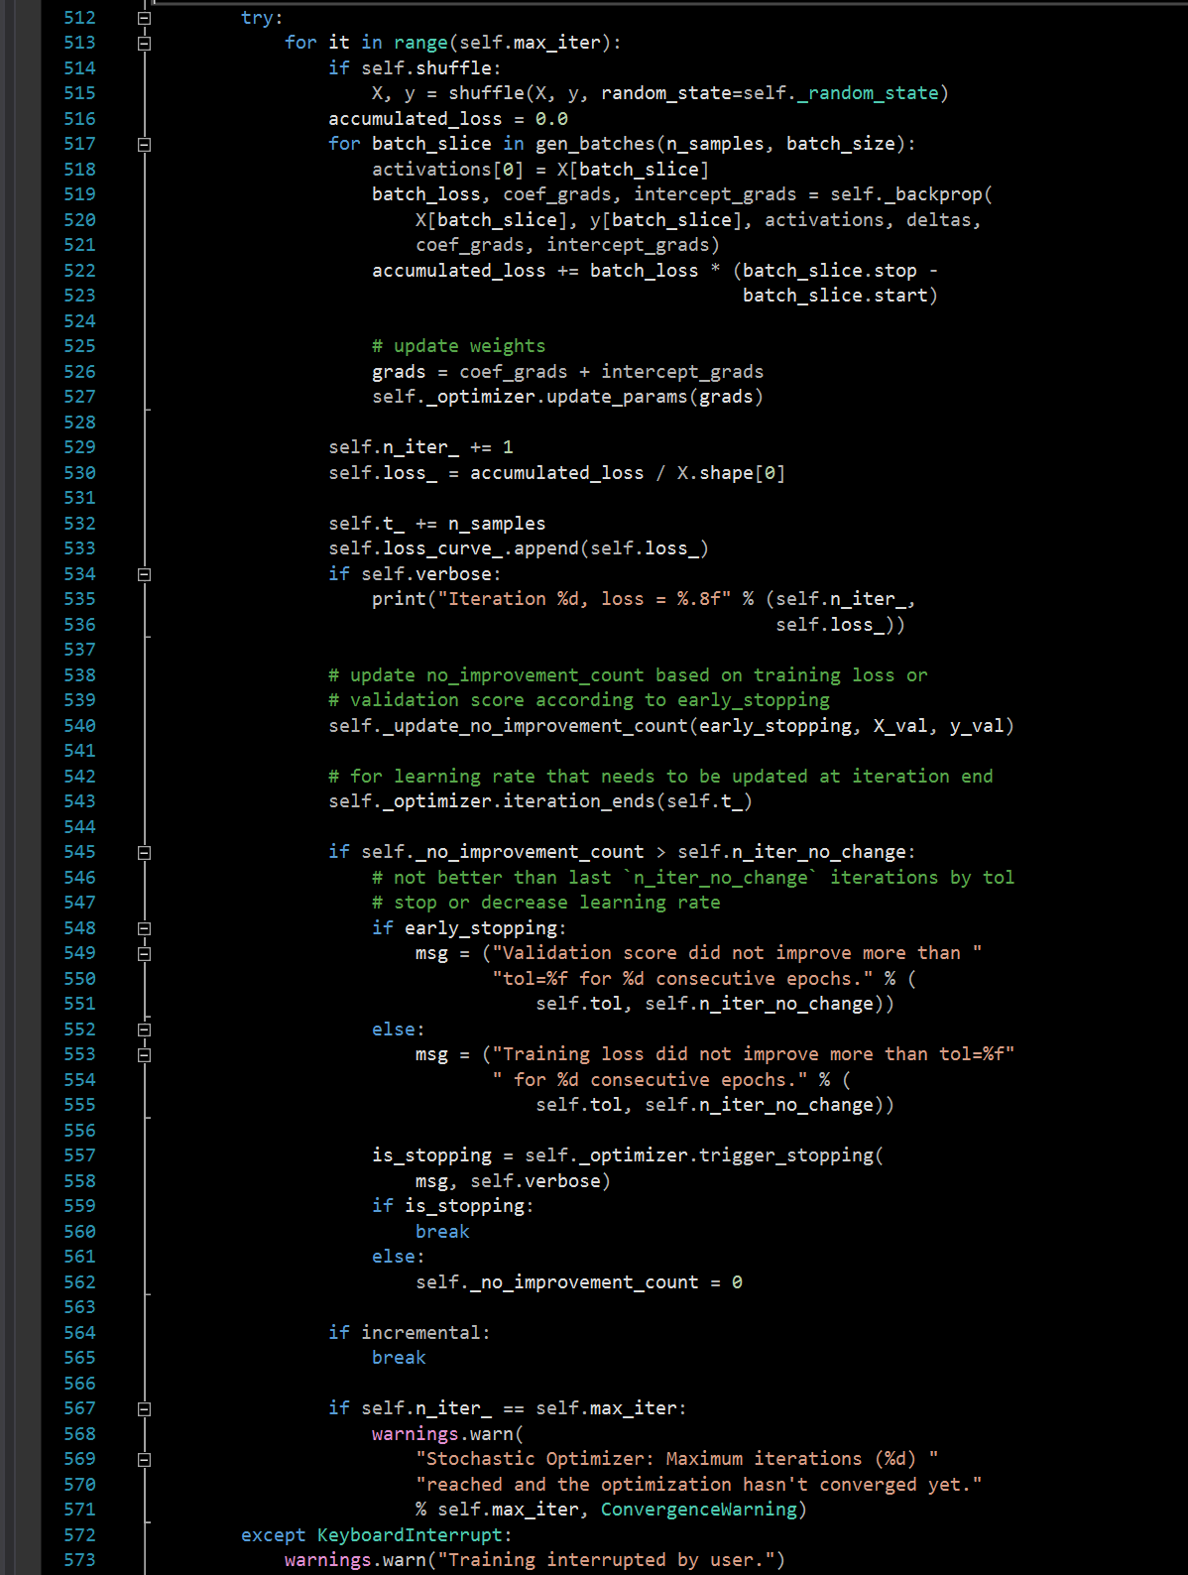
Each Iteration
Process repeated for n mini batches of training data
This loop is also within a larger loop (line 517 - right)
Control iterations, updates necessary parameters

Slide 21
We have a “trained” model one a minimum is reached

Slide 22
Multilayer Peceptron Implementation
Sklearn : “MLPClassifier”

Slide 23
MLPClassifier Object
Sklearn has an “out-of-the-box” Multilayer Perceptron Object
Can be fitted with Stochastic Gradient Descent
Can adjust various hyper-parameters as well
Learning Rate, Solver Method, Maximum iterations, Tolerance, etc.

Slide 24
“Off of the Shelf”
Easy Implementation, Great documentation
Several layers of Error Handling
Tendency to slow things down – made for most general case

Slide 25
Stochastic Fitting
Requires feature matrix X and target vector, y
Uses “mini batches” of data, implements forward passes
First place to implement approximate computations
Exact cost function can be inputted by user

Slide 26
Back Propagation
Compares network output to expected target
Fitting method uses SGD on its back-propagation algorithm
Computes discrete gradient values
Used changes to update weighting matrices
Details in external Word Document

Slide 27
Matrix Multiplications
Forward Passes
(line 91)
Back Propagations
(line 181)
Lines 102 – 109 in “BaseMulitlayerPerceptron.py”
Call to external math library
“safe_sparse_dot()”
Uses scipy and built-in matrix product methods
Lines 242 – 254 in “BaseMultilayerPerceptron.py”
Call to external math library
“safe_sparse_dot()”
Uses scipy and built-in matrix product methods

Slide 28
Resources
Geron, Aurelien. Hands-on Machine Learning with Scikit-Learn and TensorFlow: Concepts, Tools, and Techniques to Build Intelligent Systems. O’Reilly, 2017.
Goodfellow, Ian, et al.Deep Learning. MIT Press, 2017.
James, Gareth, et al. An Introduction to Statistical Learning with Applications in R. Springer, 2017.
Petrik, Marek. “Introduction to Machine Learning.” Machine Learning. 04 March 2020, Durham, New Hampshire
Sanderson, Grant. But What Is A Neural Network? 3Blue1Brown, www.3blue1brown.com/neural-networks.

